Slide 1
Forces SandBox
By Group #2
James Hribal, James Crocker, Alex Arithmitis

Slide 2
Idea/Goal
Create a simulator of forces (i.e. gravitation and spring force) on objects
Integrate graphic user interface (GUI) so user can see the forces acting on the object(s)

Slide 3
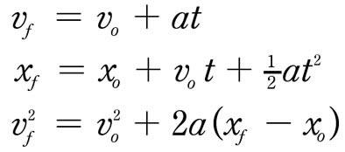

Equations Used
Kinematic equations:
Newton’s Second Law

Slide 4
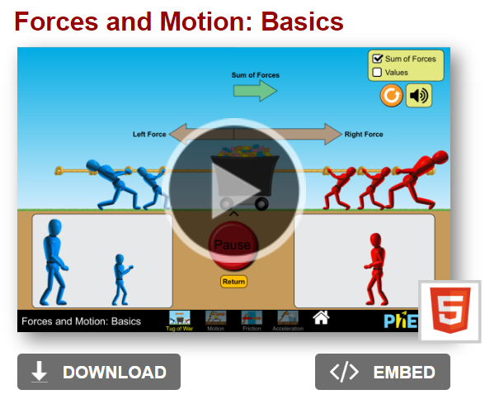
Examples of Previously Created Force Simulators
Physics simulator

Slide 5
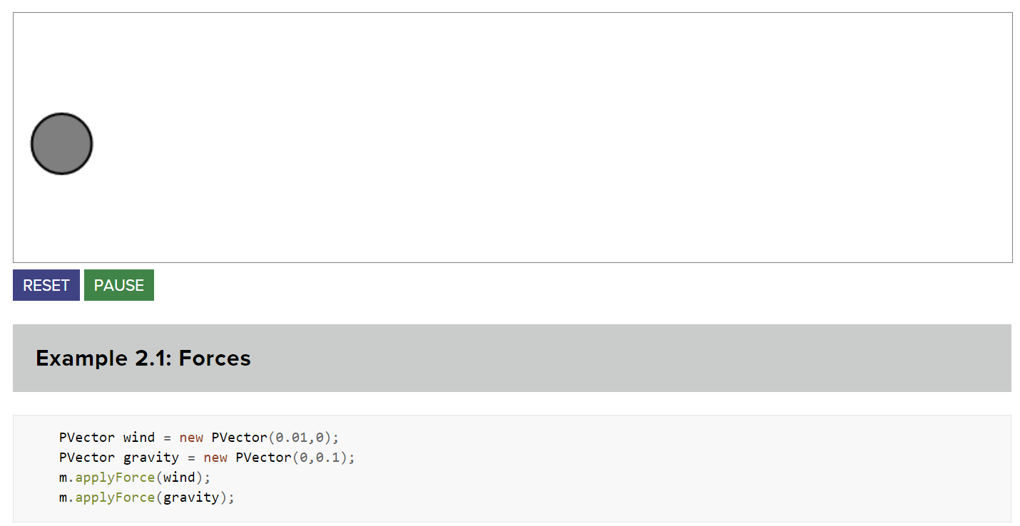
Examples of Previously Created Force Simulators (Cont.)
Simple Forces Simulator

Slide 6
Our Code
Currently our code is able to simulate the forces acting on a point/points in space without any GUI

